Slide 1

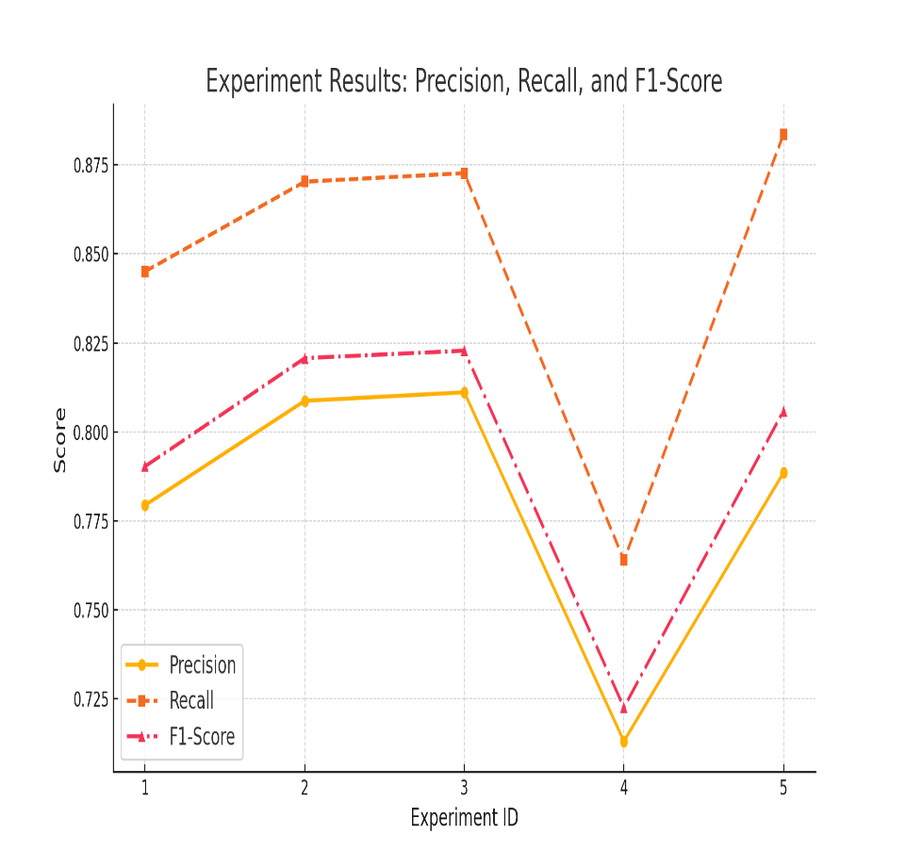

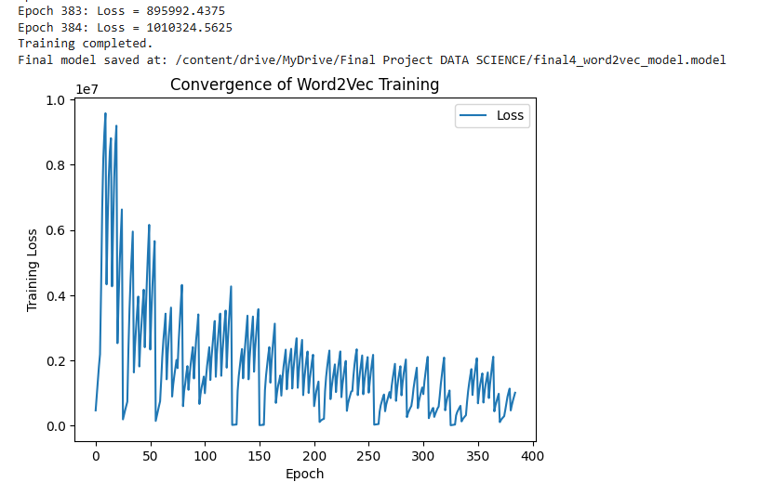
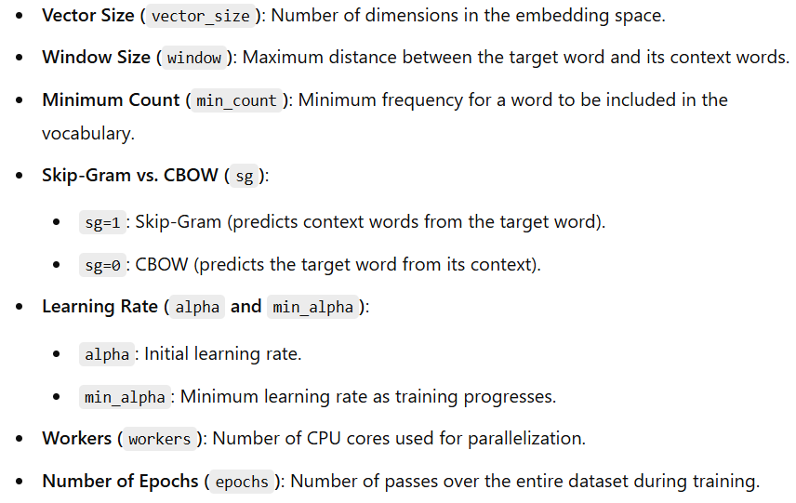


Word2Vec Recommender System
*Artist based word2vec model recommender *
Best model chosen is 3 based, best f1 score

